Slide 1
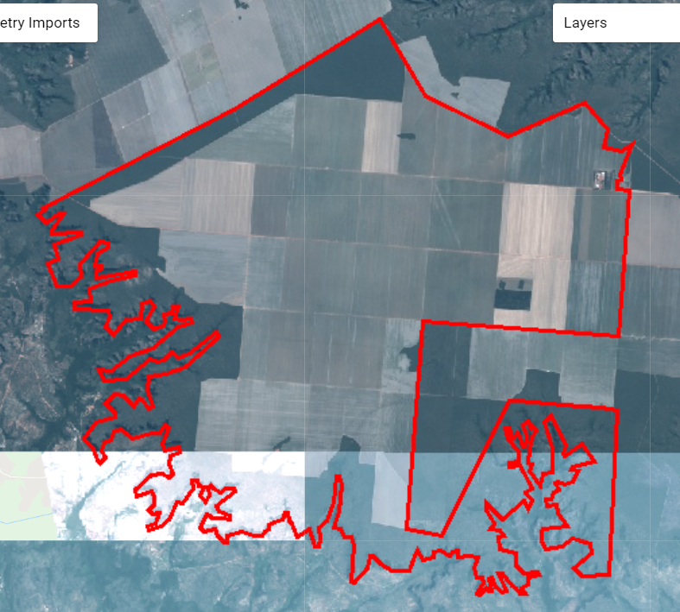
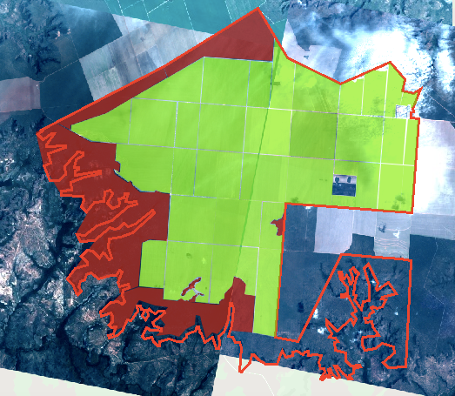
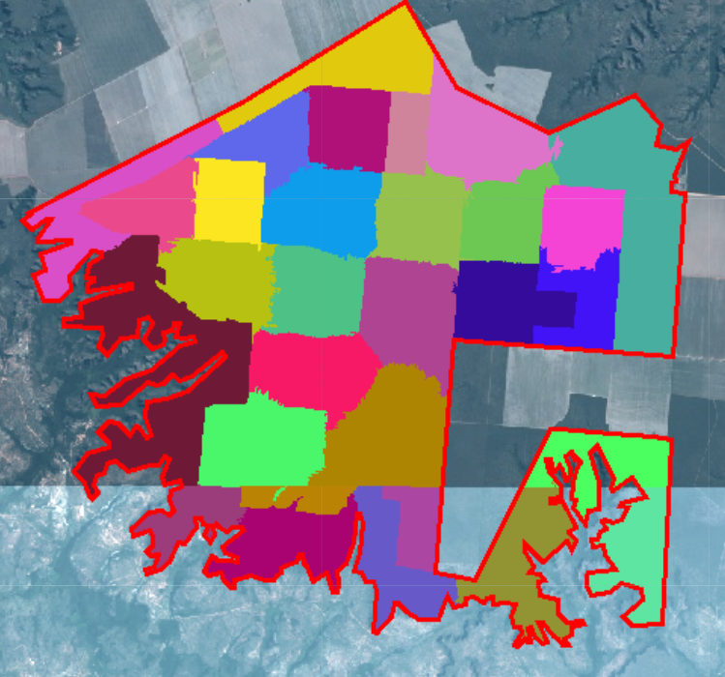
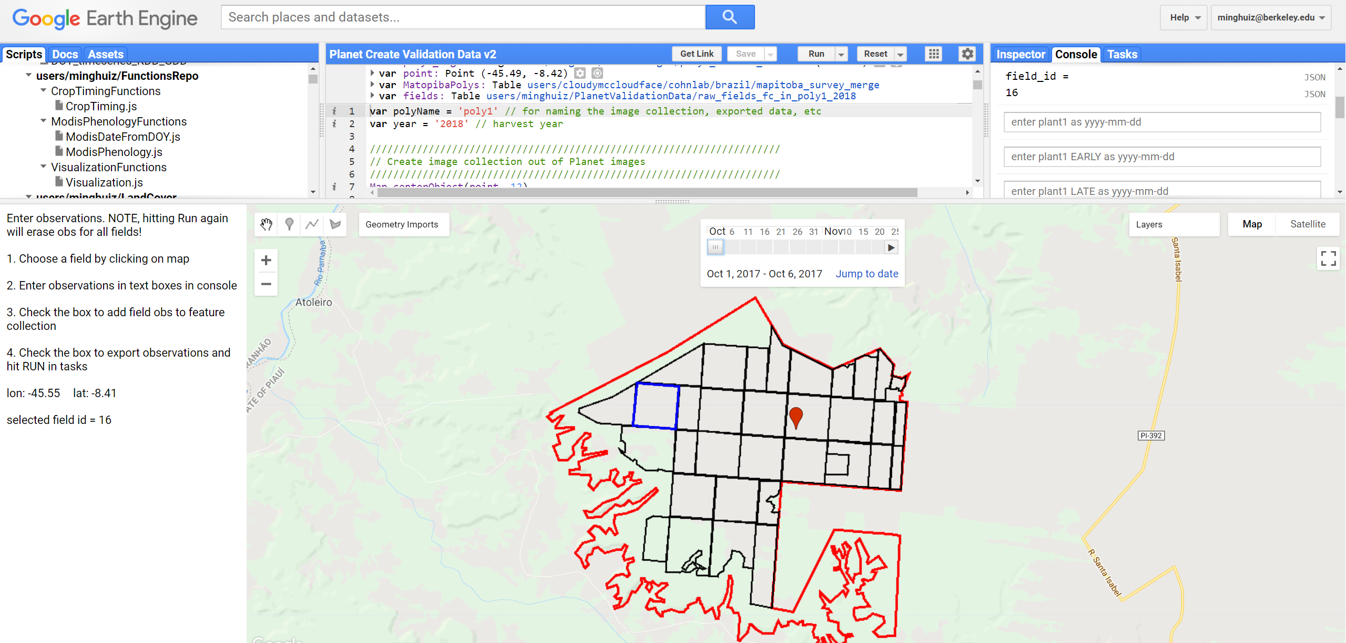
Planet images –> crop timing, crop intensity, and land cover validation data
Planet Scope cloud free images, 2017 - 2018
Manual
Automatic
First, separate CAR poly into individual fields (manually or automatically); visually classify image as agri, natural, center pivot, urban
GEE file: LandCover/Planet Manual Field Delineation
GEE file: LandCover/Planet OBIA
Second, click through images and enter planting, harvest, and crop intensity for individual fields
GEE file: LandCover/Planet Create Validation Data v2

Slide 2
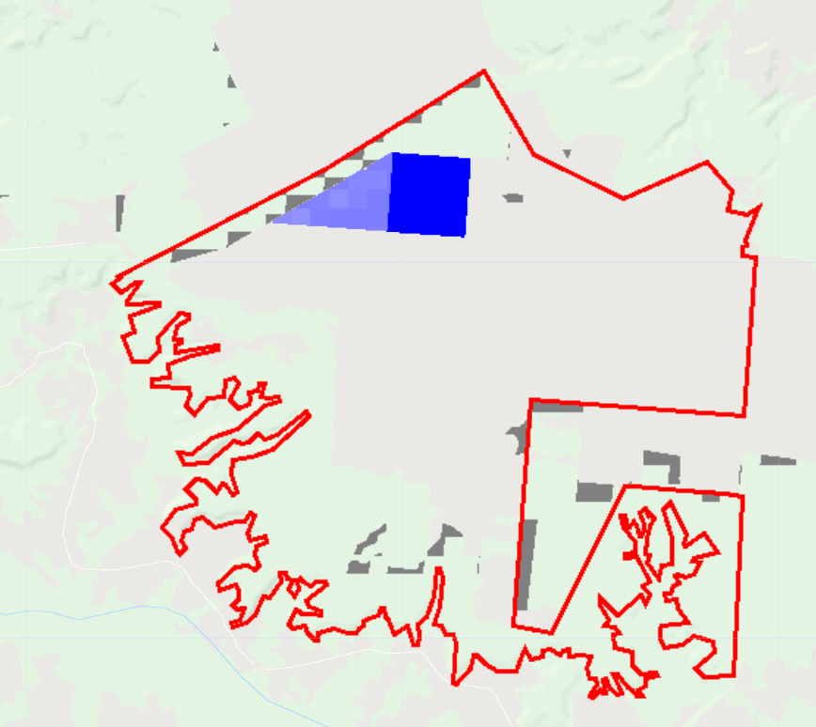
Planet images –> crop timing, crop intensity, and land cover validation data
Third, create validation maps/stats for crop timing
Blue: error in crop timing at pixel scale (number of days between Planet-estimated plant/harvest and my estimate)
Planet-estimated crop timing comes with a range of potential dates
Gray: natural vegetation that was misclassified as agriculture
Confusion matrix for crop intensity classification (SC vs DC)
GEE file: LandCover/Planet Do Validation

Slide 3
General problems with land cover classification:
1. Training data are few (especially outside of MT) and perhaps erroneous
New MT training data from Avery
Pool existing training data across years
Create new training data from:
Planet images
Google Earth Pro (visual inspection for soy vs nonsoy)
2. Don’t know what characteristics can best separate classes
Spectrally: Band by band scatterplots to get vegetation index
Phenologically: Temporal principal components
Trial and error: Test different input data

Slide 4
Issue 1: soy vs nonsoy classification is inaccurate
Not enough training data for soy vs non soy in original dataset
There’s a lot of timing variation within soy, perhaps more than for soy vs nonsoy
Solution:
Use new training dataset based in MT (GEE asset ‘MT_ground_reference_data_PLOS_2017’, 675 points from 2003 to 2015)
Train a single classifier across years (to pool up nonsoy agri training points)
Improve the input data by determining what separates soy from nonsoy
Spectrally: Create band-by-band scatterplots using Sentinel in GEE. Look at multiband indices.
Phenologically: Temporal principle components applied to individual pixels to find principle trajectories that give the most variation
See the full variety of soy vs non soy timing. See whether SC/DC soy varies more than soy vs nonsoy
Use this information to update input data (right now: 8 day aqua composite + 32 day Landsat NDVI + terrain)
Create new soy vs nonsoy training in Matopiba and other areas of Brazil
Visually: Take the set of existing training points and look in Google Earth Pro for row patterning of soy vs nonsoy to create new training points
Search for more ground truth data… upcoming survey of soy farms in Brazil
Issue 2: SC soy vs DC soy classification is inaccurate
Sensitive to the set of input training points. Potential reasons:
Training points aren’t capturing the range of SC vs DC, or are badly geolocated
Input bands aren’t temporally refined/appropriate
Solution:
Generate training data for crop intensity, especially outside of MT, using Planet imagery. Pay attention to triple cropping/failed first crops – add more nuanced crop intensity classifications. Add in new training dataset (PLOS) for MT. Use these to redo SC/DC classifications.
Temporal principle components: categorize trajectories of SC vs DC to pinpoint what can best separate them in each region
New input bands:
Peak detection method -> dates of peaks (use dates of certain events, in addition to actual EVI values, as training)
Sentinel 2 (higher temporal resolution)
Issue 3: center pivot classification
Solution:
Take the difference of the annual min and max EVI, use the difference to find the circle. Then do object based classification of the circle in GEE. Try this with Sentinel for higher revisit time compared to Landsat (get irrigation in recent years)
Doesn’t solve raster -> vector issue at scale, but could avoid certain densities of center pivot using only the raster layer
Ask Jill Danes at Stanford about center pivot in Brazil

